Slide 1

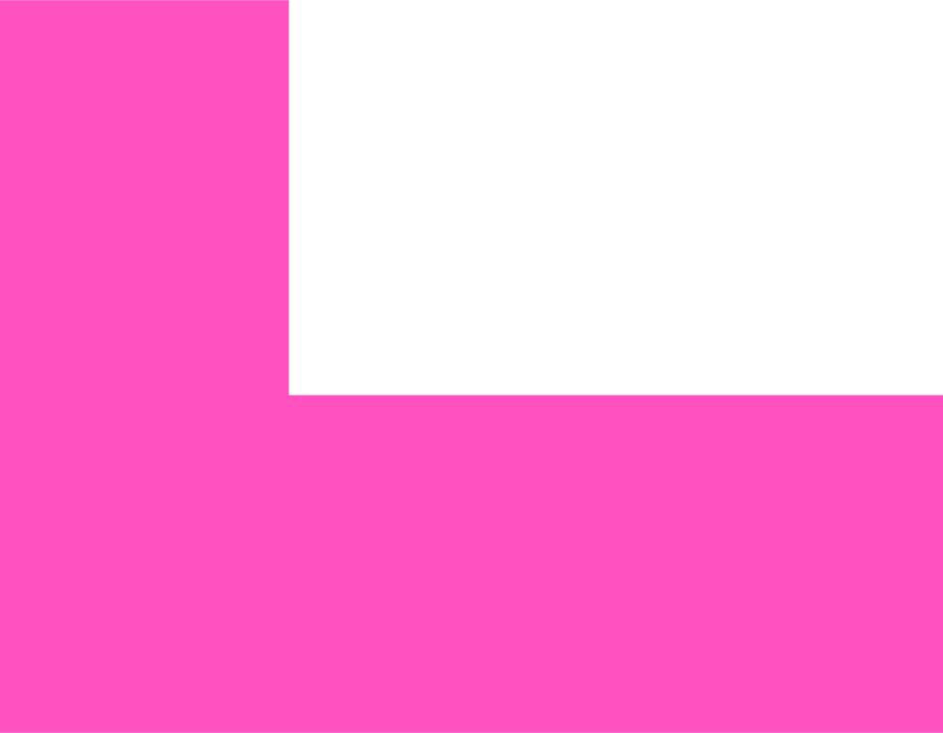
Software Engineering
Day3 – Implementation Testing
Understanding the Foundation of Modern Technology

Slide 2
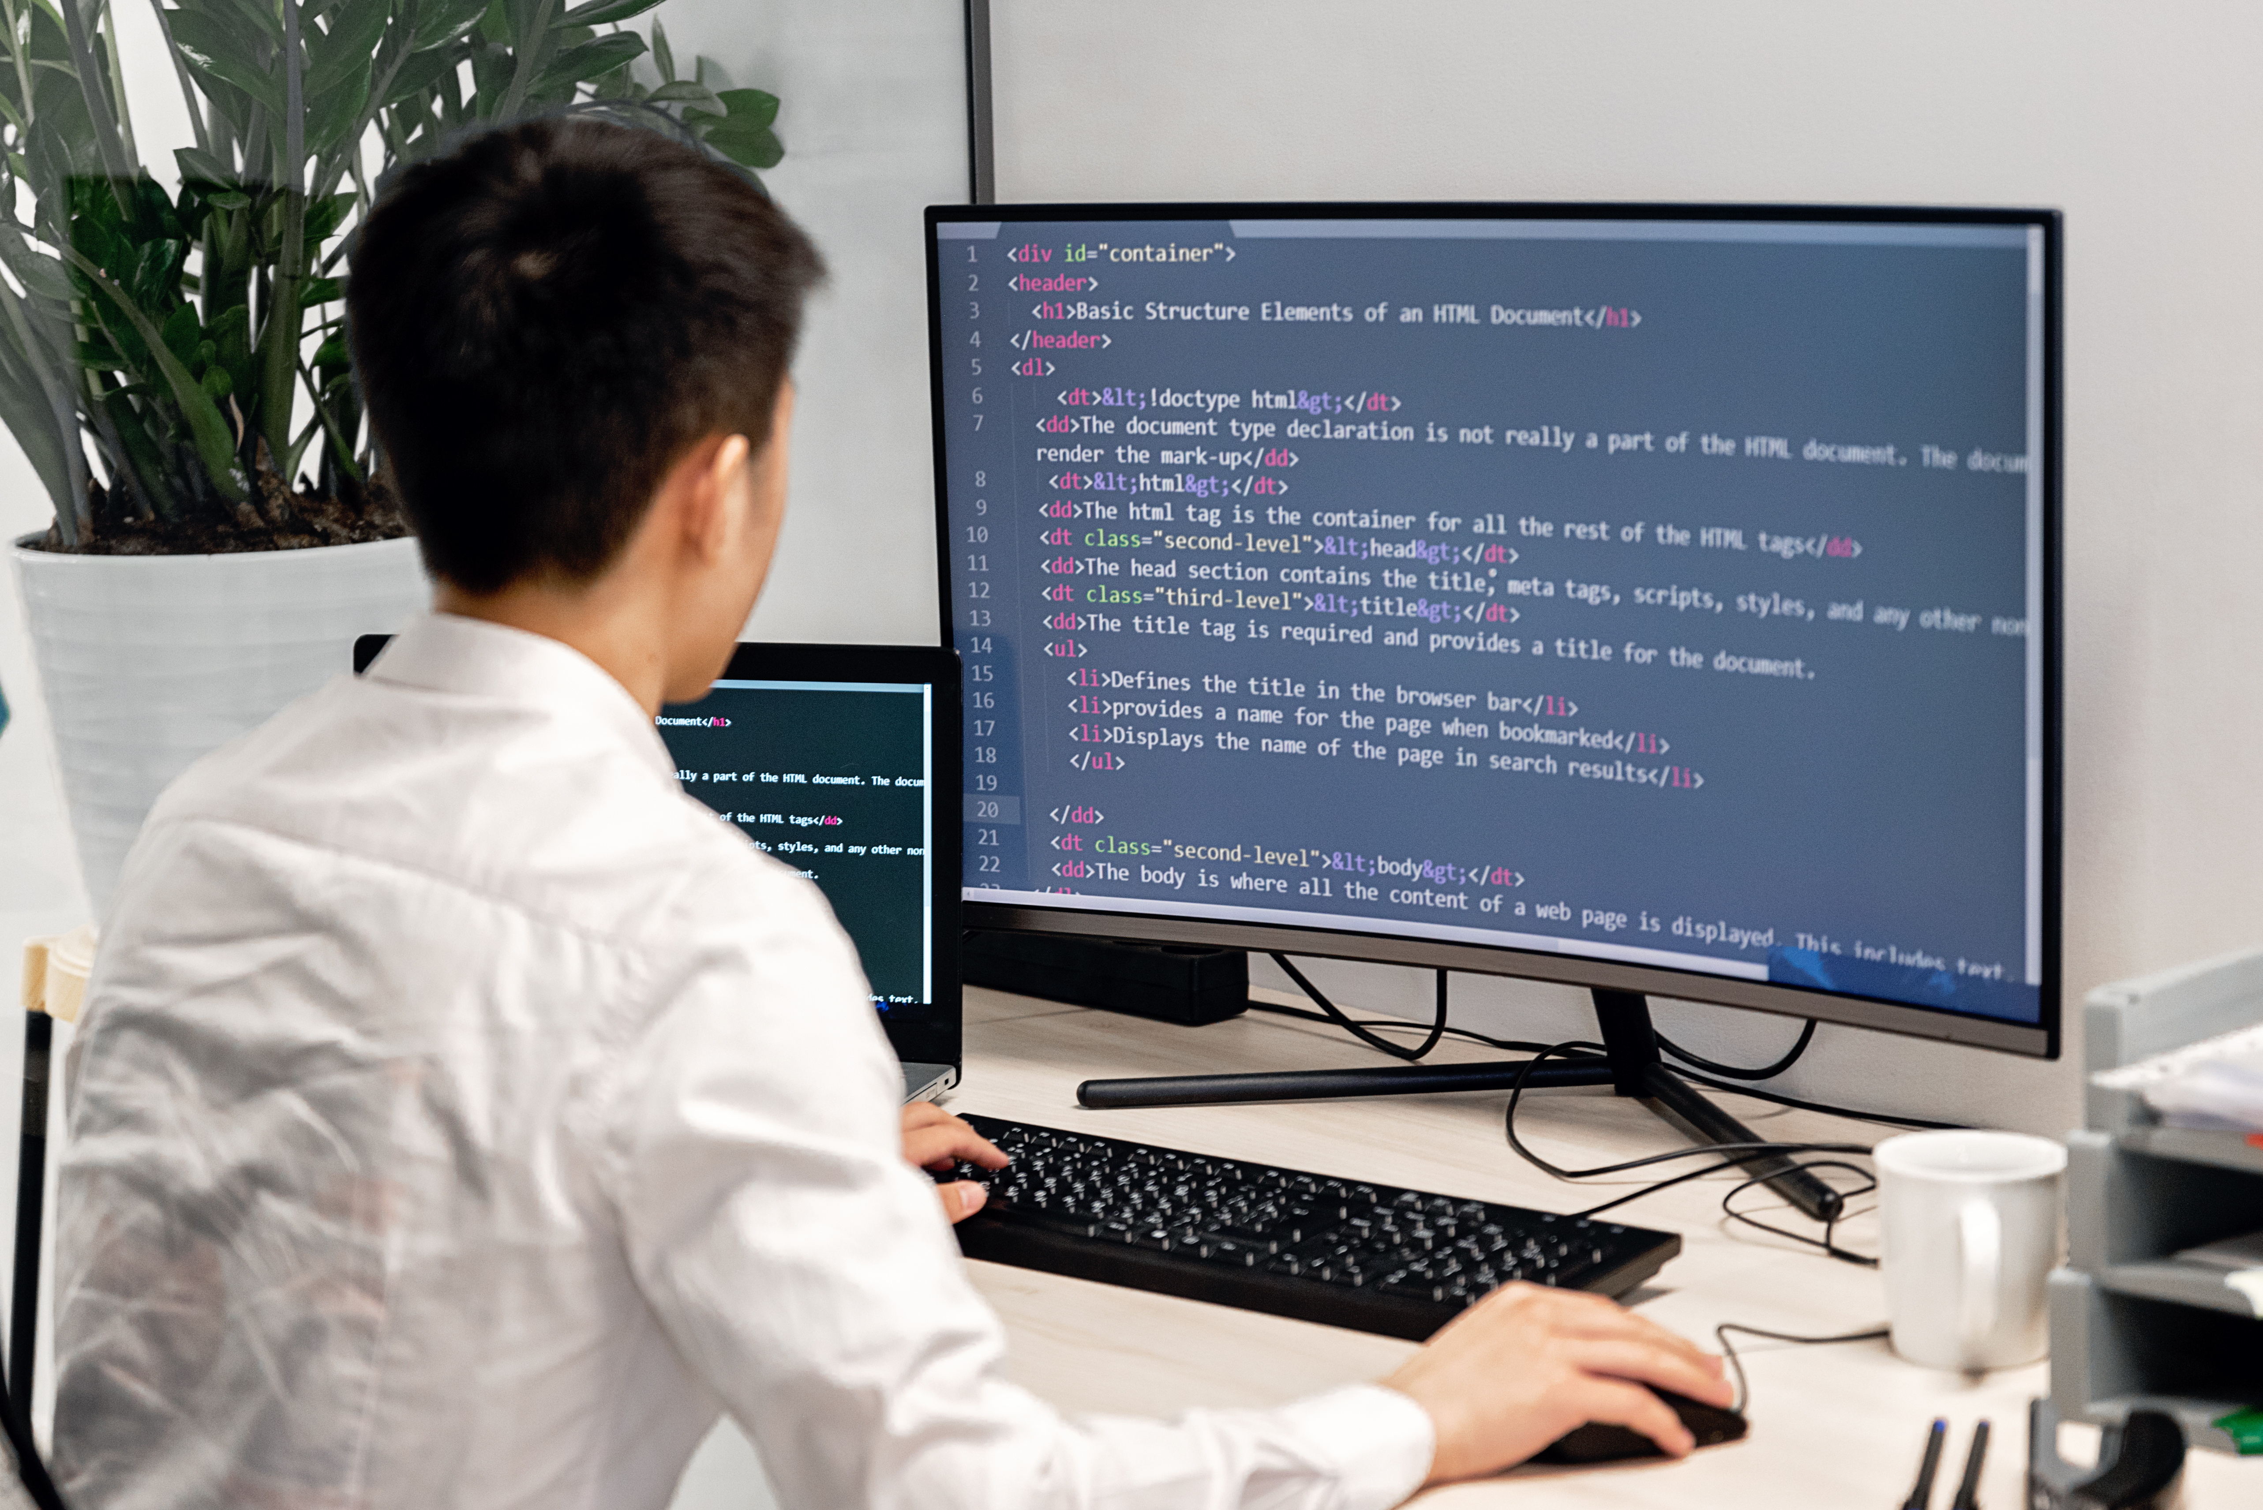
Wellcome Back!
Journey So Far
✅ Day 1: SE Fundamentals & Project Setup
✅ Day 2: Requirements Analysis & System Design
🎯 Today: Turn designs into working, tested code!
🎯 Today's Mission
"Write clean, maintainable code that actually works and proves it with tests!"
📋 Today's Agenda
Clean Code Principles
Error Handling Strategies
Testing Fundamentals
Hands-on: Implement & Test Task Manager
Notes:
Code yang tidak bisa di-debug
Project yang tidak pernah selesai
Kerja sama tim yang kacau
Code yang sulit dipahami setelah beberapa bulan

Slide 3

The Implementation Challenge
From Design to Reality
😰 Common Developer Fears
"Will my code actually work?"
"What if I break something?"
"How do I know if it's correct?"
"What happens when users do unexpected things?"
🎯 Today's Solutions
Clean Code: Write code that's easy to understand and maintain
Error Handling: Gracefully handle unexpected situations
Testing: Prove your code works and catch bugs early
Best Practices: Industry-standard approaches
💡 Key Insight
"Good code is not just code that works—it's code that works reliably, handles errors gracefully, and can be easily maintained by others."

Slide 4
Clean Code Principles
Code is Read More Than Written
📚 The Reality Check
Code is written once
Code is read hundreds of times
Code is modified by different people
Code lives for years (sometimes decades)
🎯 Clean Code Goals
Readable: Anyone can understand what it does
Maintainable: Easy to modify and extend
Reliable: Works correctly in all scenarios
Efficient: Performs well without unnecessary complexity

Slide 5
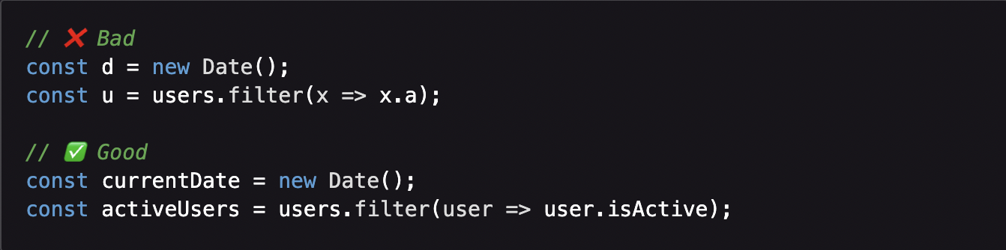
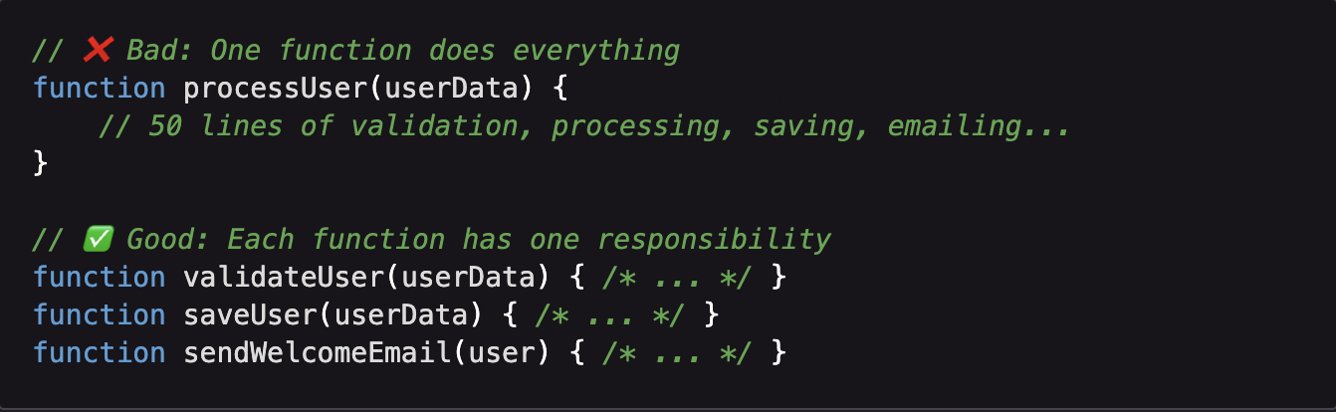
Clean Code Rules
The Fundamentals
📝 Meaningful Names
🎯 Small Functions

Slide 6
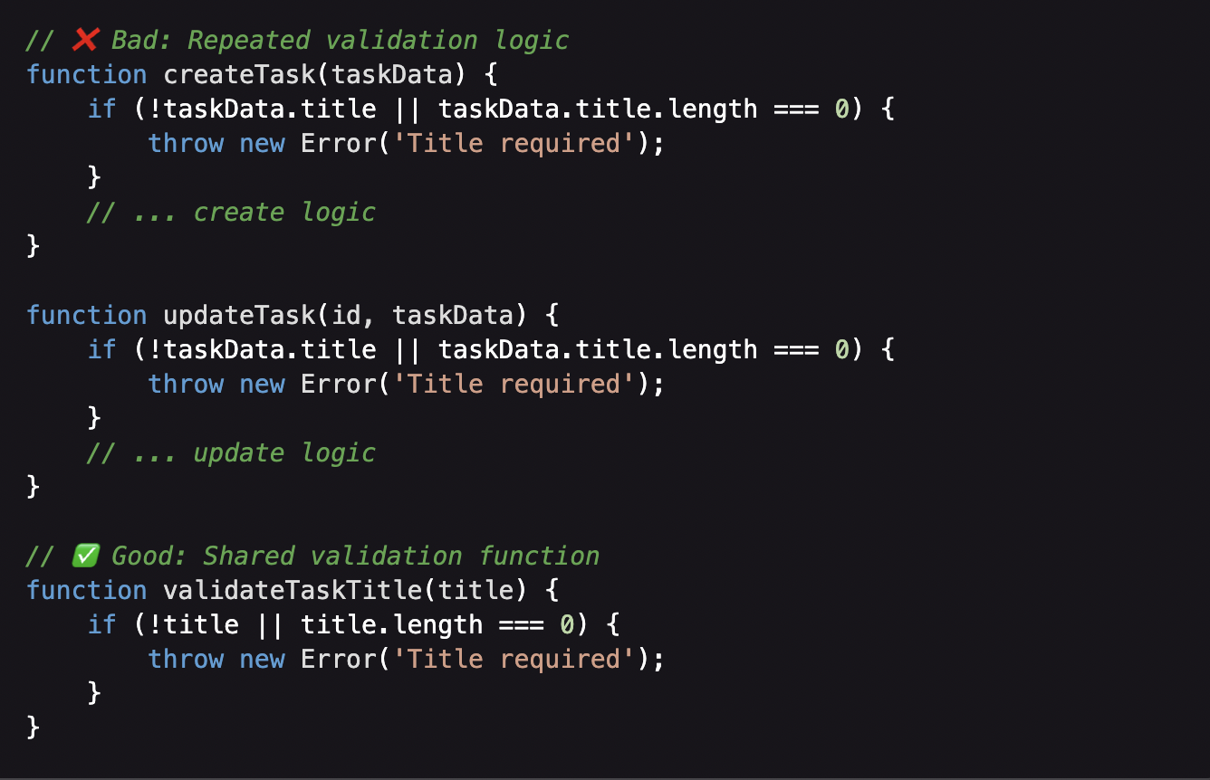
DRY and KISS Principle
Don't Repeat Yourself & Keep It Simple, S….d
🔄 DRY - Don't Repeat Yourself
💎 KISS - Keep It Simple
Choose simple solutions over complex ones
Add complexity only when necessary
"Premature optimization is the root of all evil"

Slide 7
Error Handling Philosophy
Expect the Unexpected
🤔 What Can Go Wrong?
User enters invalid data
Database connection fails
Network request times out
File system is full
Third-party API is down
Memory runs out
🛡️ Defensive Programming
Validate all inputs: Never trust user data
Handle all errors: Don't let exceptions crash your app
Provide fallbacks: Graceful degradation when possible
Log everything important: Help future debugging
🏥 Medical Analogy
Prevention: Input validation (vaccines)
Treatment: Error handling (medicine)
Monitoring: Logging (health checkups)

Slide 8
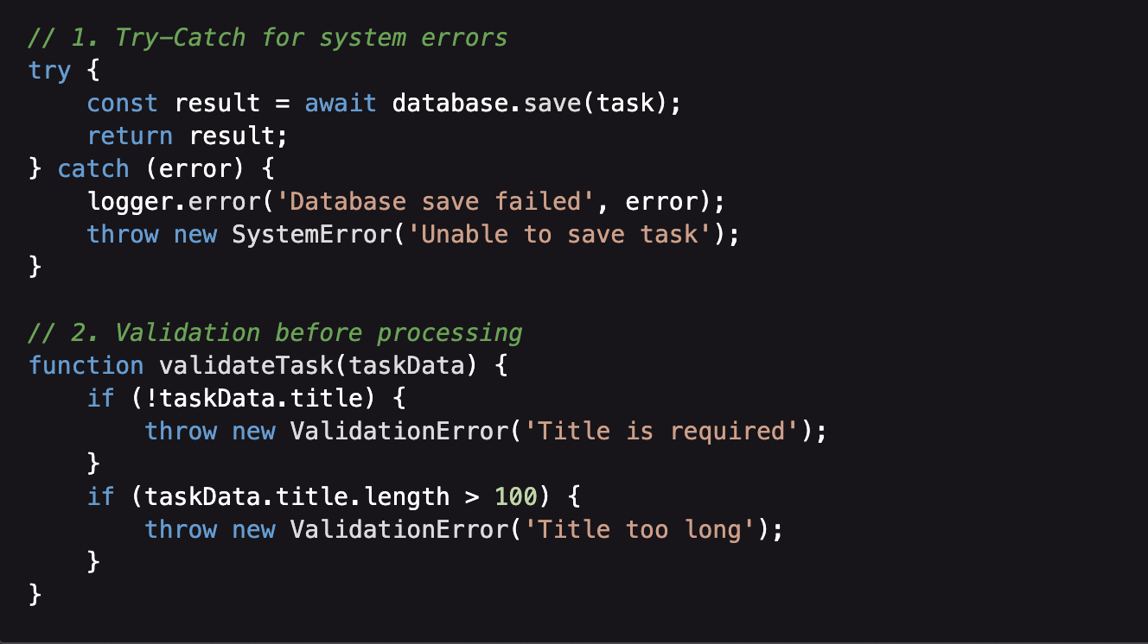
Error Handling Strategies
How to Handle Things Going Wrong
🚨 Error Types
Validation Errors: Invalid user input
Business Logic Errors: Rule violations
System Errors: Database, network, file system
Unexpected Errors: Bugs, edge cases
🛠️ Handling Strategies

Slide 9
User-Friendly Error Messages
Communicate Clearly with Users
❌ Bad Error Messages
"Error 500: Internal Server Error"
"NullPointerException at line 247"
"Database connection failed: Connection timeout"
"Validation failed"
✅ Good Error Messages
"Please enter a task title"
"Task title must be less than 100 characters"
"Unable to save your task right now. Please try again."
"This email address is already registered"
🎯 Error Message Guidelines
Clear: Explain what went wrong
Actionable: Tell user what to do next
Friendly: Don't blame the user
Secure: Don't expose system internals

Slide 10
Testing Fundamentals
Why Test Your Code?
😱 The Cost of Bugs
Development: 1x cost to fix
Testing Phase: 10x cost to fix
Production: 100x cost to fix
After Release: 1000x cost to fix (reputation, customers, lawsuits)
🎯 Benefits of Testing
Confidence: Know your code works
Regression Prevention: Catch bugs when making changes
Documentation: Tests show how code should be used
Design Feedback: Hard-to-test code is usually poorly designed

Slide 11
Types of Testing
The Testing Pyramid
🔺 Testing Pyramid
/\
/ \ E2E Tests (Few, Slow, Expensive)
/ ___\
/ \ Integration Tests (Some, Medium)
/ _______\
/ \ Unit Tests (Many, Fast, Cheap)
/___________\
🧪 Unit Testing
Test individual functions/classes
Fast, isolated, focused
Example: Test validateTask() function
🔗 Integration Testing
Test how components work together
Medium speed, realistic scenarios
Example: Test TaskController + TaskService + Database
🌐 End-to-End Testing
Test complete user workflows
Slow but comprehensive
Example: Test entire "create task" user journey

Slide 12
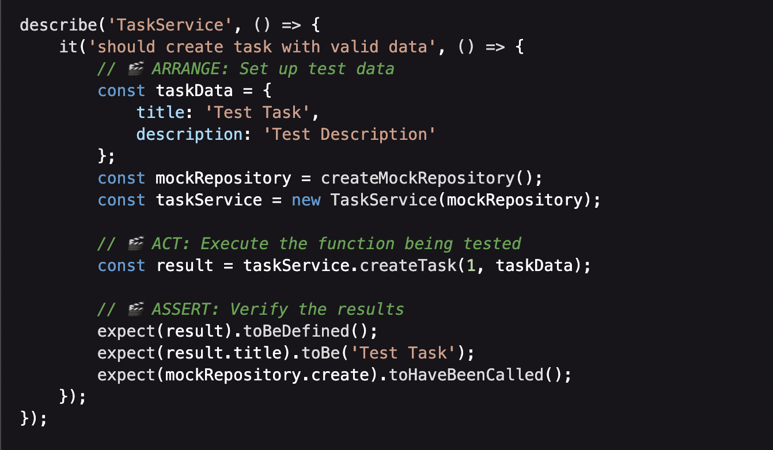
Unit Testing Best Practices
AAA Pattern | Arrange - Act - Assert
📋 AAA Structure
✅ Good Test Characteristics
Fast: Runs in milliseconds
Independent: Doesn't depend on other tests
Repeatable: Same result every time
Self-validating: Clear pass/fail
Timely: Written close to production code

Slide 13
Test-Driven Development (TDD)
Red-Green-Refactor
🔄 TDD Cycle
🔴 Red: Write failing test first
🟢 Green: Write minimal code to pass
🔵 Refactor: Improve code quality
Repeat: Next feature
💡 TDD Benefits
Better Design: Forces you to think about interfaces
Complete Coverage: Every line has a test
Confidence: Know exactly what your code should do
Documentation: Tests describe expected behavior
🤔 When to Use TDD
✅ Complex business logic
✅ Bug fixes (write test that reproduces bug first)
✅ New features with clear requirements
❌ Exploratory coding or prototyping

Slide 14
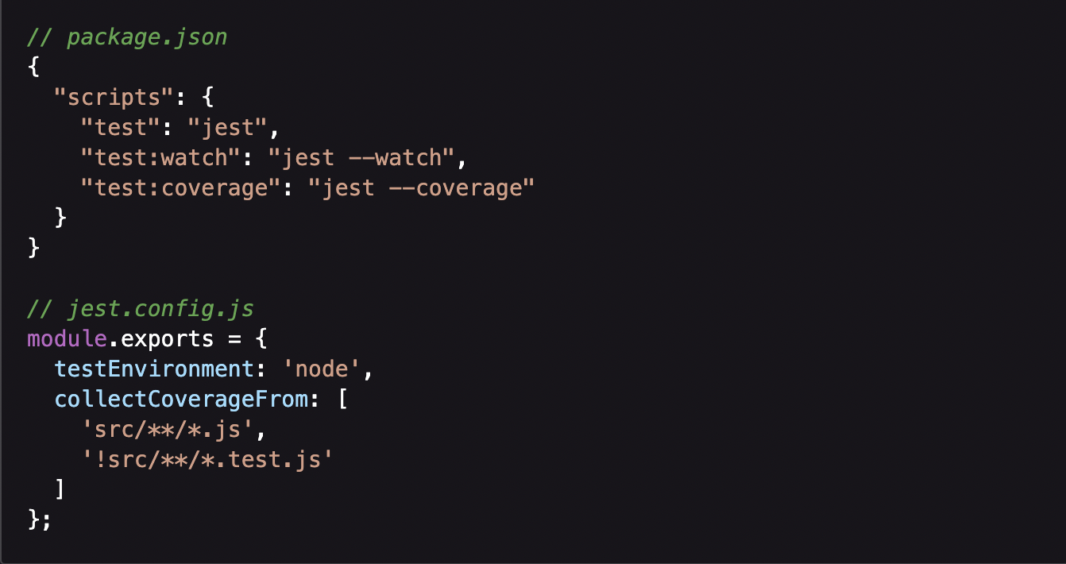
Testing Tools & Framework
JavaScript Testing Ecosystem
🧪 Jest - Our Testing Framework
🛠️ Setup Example
Why Jest: Popular, easy to use, built-in mocking
Features: Test runner, assertions, mocking, coverage
Syntax: Familiar describe/it structure
📊 Code Coverage
Why Jest: Popular, easy to use, built-in mocking
Features: Test runner, assertions, mocking, coverage
Syntax: Familiar describe/it structure

Slide 15
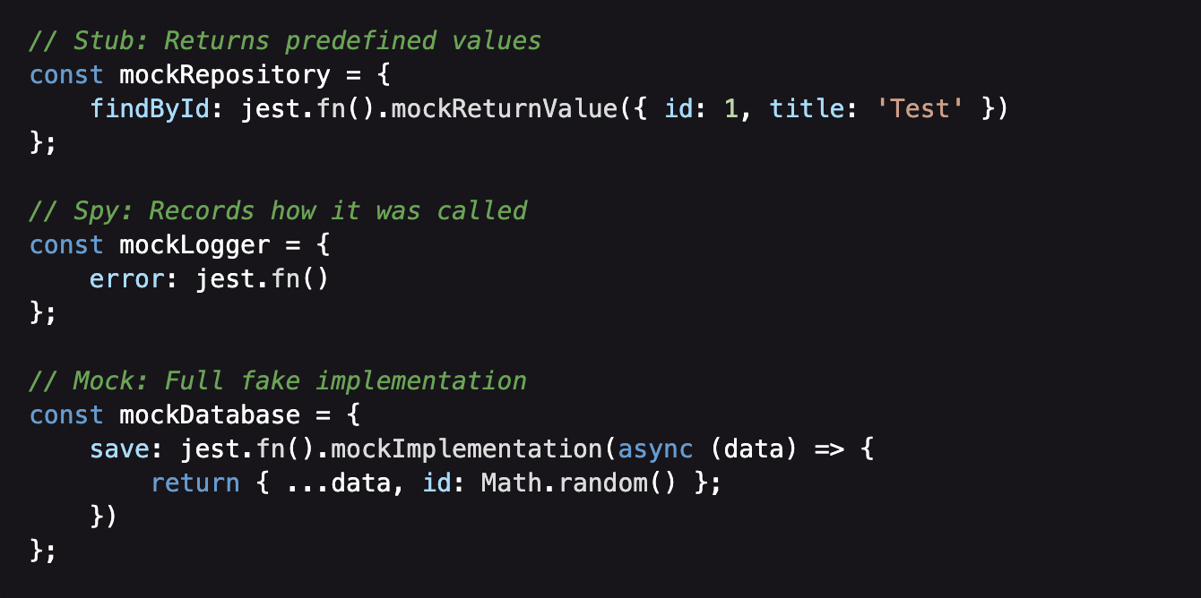
Mocking & Test Doubles
Isolating Units Under Test
🎭 Why Mock?
🎪 Types of Test Doubles
Isolation: Test one thing at a time
Speed: Avoid slow database/network calls
Control: Simulate different scenarios
Reliability: Tests don't depend on external systems
⚠️ Mocking Guidelines
Mock external dependencies, not your own code
Keep mocks simple
Verify important interactions

Slide 16
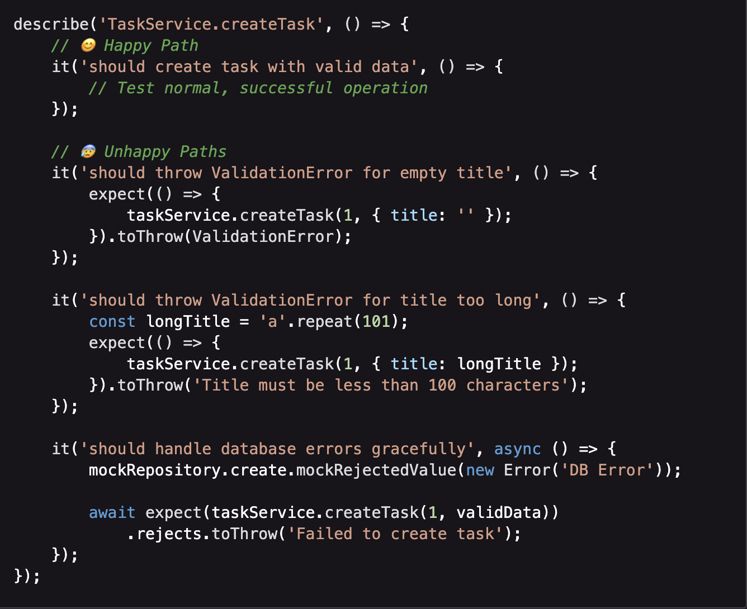
Error Handling Testing
Testing the Unhappy Path
🛤️ Happy Path vs Unhappy Path

Slide 17
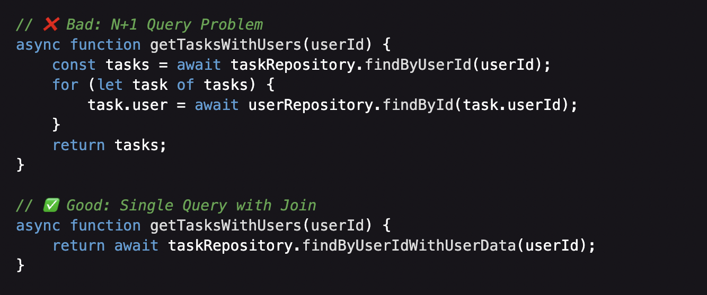
Performance Consideration
Writing Efficient Code
⚡ Performance Best Practices
📊 Example: Efficient Task Loading
Avoid N+1 Queries: Load related data efficiently
Use Appropriate Data Structures: Arrays vs Objects vs Maps
Cache Expensive Operations: Database queries, API calls
Lazy Loading: Load data only when needed
⚖️ Performance vs Readability
Start with readable code
Optimize only when you have performance problems
Measure before optimizing
"Premature optimization is the root of all evil"

Slide 18
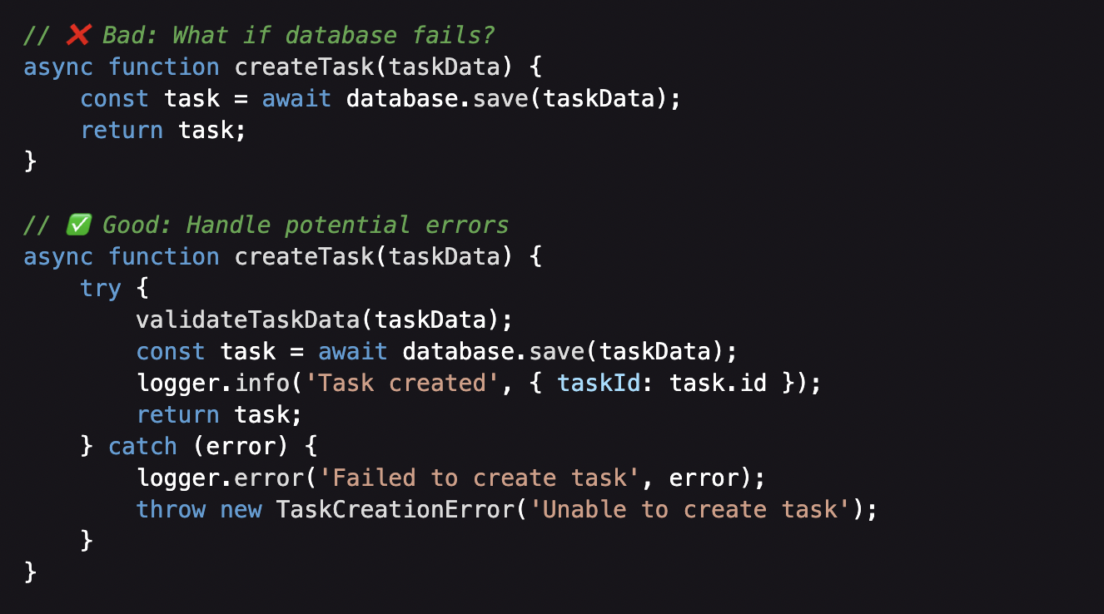
Common Implementation Pitfalls
Learn from Others' Mistakes
🕳️ Pitfall 1: No Error Handling
🕳️ Pitfall 2: Testing Only Happy Paths
80% of bugs happen in error scenarios
Test edge cases: empty inputs, boundary values
Test error conditions: network failures, invalid data

Slide 19
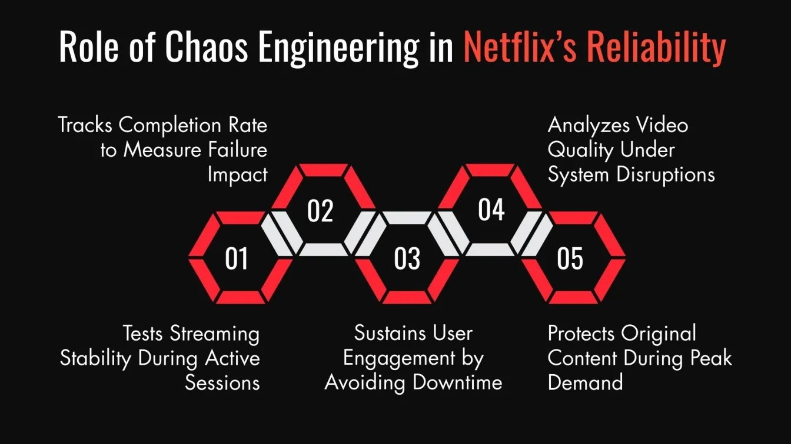
Real-World Testing Example
How Netflix Tests Their Code
🎬 Netflix Testing Strategy
Unit Tests: 70% of all tests
Integration Tests: 20% of all tests
E2E Tests: 10% of all tests
🐒 Chaos Engineering
Chaos Monkey: Randomly kills production services
Philosophy: "If it can break, it will break"
Result: Systems that are resilient to failures
📊 Testing Metrics
Code Coverage: 80%+ for critical services
Test Execution Time: < 10 minutes for full suite
Flaky Test Rate: < 1% (tests that randomly fail)
📊 Testing Metrics
"Netflix can deploy code 1000+ times per day because they have comprehensive automated testing!"

Slide 20
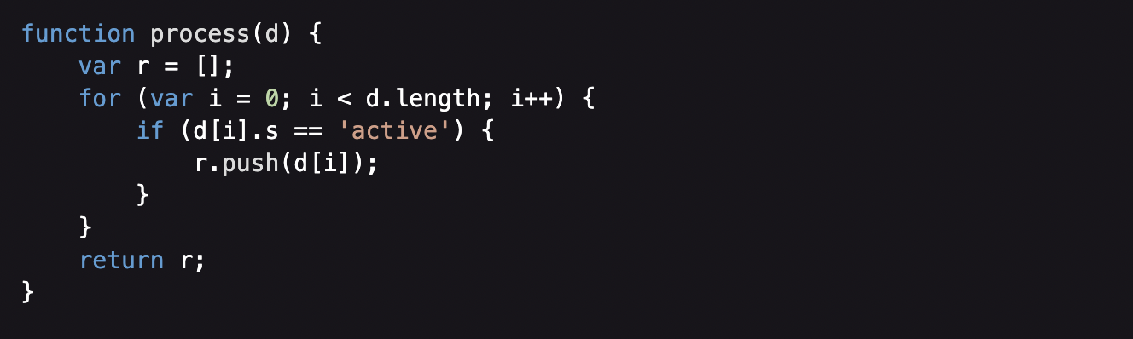
Interactive Exercise
Spot the Problems
🔍 Code Review Challenge
🤔 Discussion Questions (5 minutes)
What problems do you see?
How would you improve this code?
What would you test?

Slide 21
Quiz Time!
Implementation & Testing Knowledge Check
1. What makes code "clean"?
A) It has no bugs
B) It's easy to read and maintain
C) It runs fast
2. When should you write tests?
A) After all features are complete
B) Only when bugs are found
C) Throughout development
3. What's the AAA pattern in testing?
A) Always Assert Accurately
B) Arrange, Act, Assert
C) Automated, Accurate, Actionable
4. Why do we mock dependencies in unit tests?
A) To make tests run faster
B) To isolate the unit being tested
C) Both A and B

Slide 22
Questions & Discussion

Slide 23
Wrap-Up
Key Takeaways
🧠 Concepts Learned
Clean code principles and best practices
Error handling strategies and patterns
Testing fundamentals and TDD approach
Code quality tools and automation
💻 Practical Skills
Writing maintainable, readable code
Implementing comprehensive error handling
Creating effective unit tests
Using Jest testing framework

Slide 24




Thank You
Get In Touch
+62-822-1367-2972
http://toni.Kusnandar.dev
toni@Kusnandar.dev

